Slide 1
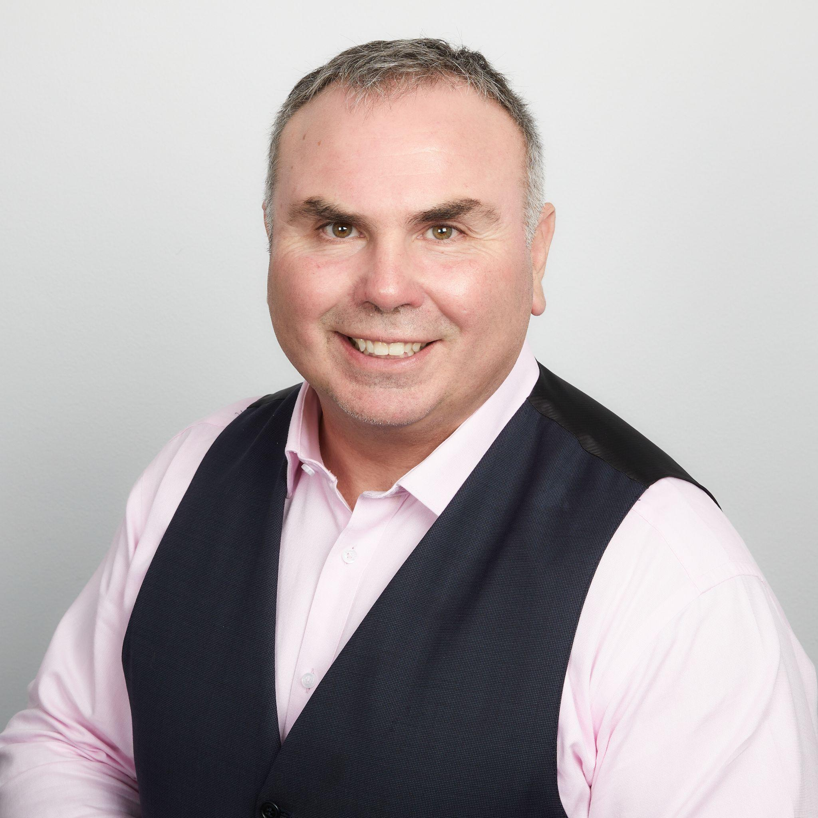
BRAD TWYNHAM
EMAIL: brad@bradtwynham.com
MOBILE: +61 431227132
SPEAKING PREFERENCE:
Keynote
Facilitator
MC
Workshop
Welcome/Acknowledgement of Country
PREFERRED TOPICS:
Leadership,
Technology and Leadership,
Entrepreneurial Leadership,
Adaptability and Change
SHOW REEL:
Brad Twynham

Slide 2
BRAD TWYNHAM
EMAIL: brad@bradtwynham.com
MOBILE: +61 431227132
KEYNOTE
Collision Course: The Power of Radical Thinking
We are all enroute to collide into any number of disruptive forces. Technology, workforce
transformation, globalisation, continual global economic instability and increasing customer
demands are just a few of those forces. Anyone of these forces could create significant
disruption or a significant market opportunity at any moment.
To create and maintain a sustainable business, practice or profession, there is now an imperative to develop the capabilities that go beyond being good practitioners and providers.
We need to become excellent, change agents, motivators, value creators and advisors.
This 60-minute talk set in the backdrop of what could only be described as a modern-day
legal thriller, introduces us to 5 powerful leadership capabilities that transforms our ability
to get above the noise, build resilience and become powerful value creators and why these
capabilities are so important in today’s legal practice.
Target Audience: C-Suite executives, Emerging Leaders, HR Leaders and practitioners, All Staff Gatherings
Key Takeaways:
Why the change coming towards us today is far more dangerous than in the past.
Our natural responses to disruptive ideas and how to overcome them.
Why new ways of thinking are required by leaders.
The 5 Radical Capabilities that can build resilience, make us adaptable and turn us into value creators.

Slide 3
BRAD TWYNHAM
EMAIL: brad@bradtwynham.com
MOBILE: +61 431227132
KEYNOTE
Radical Innovation: 5 Technologies that will alter humanity
In the last ten years technology has become pervasive to the point where the average adult is looking at the smartphone every twelve minutes.
We have seen how much the internet, smartphones and social media have changed many aspects of how we live, work and play.
What if I told you that this was just the beginning? The next ten years we will see 5 technologies start to change everything we know about the world, how we live, work and play.
This talk explores 5 technology meta trends that have the potential to make our lives unrecognisable and the disruptive potential for industry.
It takes people on a journey from being afraid of a dystopian future to embracing the positive impacts technology is going to make on their lives and their work.
Target Audience: C-Suite executives, Emerging Leaders, HR Leaders and practitioners, All Staff Gatherings, Technology Leadership Groups, Boards
Key Takeaways:
Deep dive into AI, The Metaverse, Robotics, Healthspan and Food and Agriculture.
Shift the conversation from fear to opportunity around these technologies and the changes they will bring.
Expand awareness of the opportunities these technologies can bring to your organisation.

Slide 4
BRAD TWYNHAM
EMAIL: brad@bradtwynham.com
MOBILE: +61 431227132
KEYNOTE
Radical Culture: 5 Business Lessons from the world's longest continuous culture
For somewhere between 60,000- 120,000 years aboriginal people have lived on this continent and flourished where many would have perished, creating the oldest living culture on earth. What can we learn from this culture as leaders that can radically alter our own cultures?
In a time of disengagement, burnout, shifting workforce practices and technology disruption, we need to make subtle but radical changes to our organisational and societal cultures to make them more sustainable and enduring. Bungaree is known as the first Australian in European History. A Garigal man from the Central Coast of NSW. He circumnavigated Australia with Matthew Flinder in 1893, acting as an intermediary between Flinders crew and the natives.
His story now lives through the truth telling of his direct descendants. This talk is by one of those people. A direct blood line custodian of the North of Sydney and the Central Coast of NSW.
Learn how 5 cultural elements passed down by Bungaree and his family can be applied to your culture. work practices and life and gain a greater understanding of the oldest living culture on earth and why it has endured.
Target Audience: C-Suite executives, Emerging Leaders, HR Leaders and practitioners, All Staff Gatherings
Key Takeaways:
5 key lessons from First Nations Culture that has made it ensure for 60,000+ years.
How organisations can learn from First Nations Culture how to engage and connect better with its people.
Deepen an understanding of connection and culture.
Unpack the value of storytelling in maintaining an enduring an engaging culture.
Understand how balance brings sustainability in culture.

Slide 5
BRAD TWYNHAM
EMAIL: brad@bradtwynham.com
MOBILE: +61 431227132
WELCOME TO OR ACKNOWLEDGEMENT OF COUNTRY
Brad Twynham is a direct descendant of Bungaree, of the Garigal of Broken Bay and Matora of the Walkaloa of Lower Lake Macquarie. A direct bloodline custodian of the SaltWater People North of Sydney, the Stingray people.
Brad makes welcome and acknowledgement of country truly special, through his amazing story telling, authentic truth telling, connection to culture and traditional music via the didgeridoo.
It is not often you find a professional conference speaker who is also able to give welcome and acknowledgement to country,
in an authentic and moving way.
Target Audience: Large Conferences, Award Ceremonies, Government Events and Symposiums and Association Gatherings
Key Takeaways:
Deepen an understanding of Aboriginal Culture and why Welcome and Acknowledgement of Country is so Important.
Entertaining and Engaging opening to events that moves audiences and sets a tone for the event.
Yudaki (Didgeridoo) performance that ties into the event or conference theme.

Slide 6
BRAD TWYNHAM
EMAIL: brad@bradtwynham.com
MOBILE: +61 431227132
Radical Open mindedness Workshop (4 hour workshop of 60min Boost Session)
Being able to absorb and digest ideas without our automatic bias is critical to being an effective leader in today’s fast paced business environment. The Radical Open mindedness workshop explores our automatic reaction to receiving ideas that don’t agree with our preconceived view of how the world should look and an easy to implement technique that assists us in evaluating those ideas.
Understand the science behind being a Radical leader.
Develop understanding as to we greet difficult to hear ideas.
Learn the PNI method. A simple tool for evaluating difficult ideas and discovering opportunity’s.
Work through scenarios that are specific to your business to reinforce learning.
Target Audience: Boards, Senior Leadership Teams, Innovation Teams, Business Change and Transformation Teams, Emerging leaders

Slide 7
BRAD TWYNHAM
EMAIL: brad@bradtwynham.com
MOBILE: +61 431227132
Radical Creativity Workshop (4 hour workshop or 60min Boost Session)
Most organisations when they create new products and services focus on incremental innovation. In today’s world we need Leaders to be able to lead teams that can be radically creative. Radical Creativity is the ability to create without limitations and can be the catalyst to inspire new business ideas, business models and strategies not previously envisioned. This workshop takes leaders through the process of being radically creative and move through a challenge based scenario where we rapidly create a Radically Creative Solution and pitch that to our peers.
Understand the science behind being a Radical leader and why Radical Creativity is so important.
Learn the process and techniques to access the radically creative mind.
Develop the ability to rapidly create new ideas that can solve big problems.
Develop an idea vision canvas that captures the ideas being developed.
Learn a simple formula to Pitch ideas easily and effectively.
This workshop is often coupled with the Radical Open mindedness workshop and delivered as full day workshop.
Target Audience: Senior Leadership Teams, Innovation Teams, Business Change and Transformation Teams, Emerging leaders.

Slide 8
BRAD TWYNHAM
EMAIL: brad@bradtwynham.com
MOBILE: +61 431227132
Radical Acceptance Workshop (4 hour workshop or 60min Boost Session)
Radical Acceptance is a tool for creating psychological safety and resilience within individuals and teams. This workshop explores the G.A.P method and delves into three core areas that allow us to develop the skill of Radical Acceptance. Gratitude, Acceptance and Perception.
Understand the science behind being a Radical leader and why Radical Acceptance is so important in todays VUCA world.
Learn a 5 step process for accelerating through disappointment.
Develop the capability to manage your emotional state in any situation.
Learn the G.A.P method for implementing radical acceptance either individually or as a team
This workshop is often coupled with the Radical Candour and Radical Empathy workshop and delivered as full day workshop.
Target Audience: Board, Senior Leadership Teams, Innovation Teams, Sales Teams, Business Change and Transformation Teams, Emerging leaders.

Slide 9
BRAD TWYNHAM
EMAIL: brad@bradtwynham.com
MOBILE: +61 431227132
Radical Empathy in Action Workshop (4 hour workshop or 60min Boost Session)
Most workshops focused on empathic leadership focus on Cognitive Empathy. Radical Empathy focuses on compassionate empathy. Not just as a tool for listening but as a tool to creating exceptional value for both internal and external stakeholders and customers.
Understand the science behind being a Radical leader and why Radical Empathy is so important in unlocking value.
Learn the tools to lead with compassionate empathy.
Develop the capability of green sheeting as an empathy tool to unlocking value for both internal and external stakeholders.
Develop active listening skills through scenarios and feedback.
This workshop is often coupled with the Radical Candour and Radical Acceptance workshop and delivered as a full day workshop.
Target Audience: Board, Senior Leadership Teams, Innovation Teams, Sales Teams, Business Change and Transformation Teams, Emerging leaders.

Slide 10
BRAD TWYNHAM
EMAIL: brad@bradtwynham.com
MOBILE: +61 431227132
Radical Candour Workshop (4 hour workshop or 60min Boost Session)
Radical Candour is the ability to give and receive difficult feedback. This workshop develops the capability and skills required to effectively create and manage productive negative feedback loops that can lead to exceptional learning and results for people within your organisation.
Understand the science behind being a Radical leader and why Radical Candour is so critical to healthy and safe working environments.
Learn how to give and receive negative feedback through scenario based training.
Learn the art and science of active debate.
Develop a process for introducing a culture of radical candour within your teams.
This workshop is often coupled with the Radical Acceptance and Radical Empathy workshop and delivered as full day workshop.
Target Audience: Board, Senior Leadership Teams, Innovation Teams, Sales Teams, Business Change and Transformation Teams, Emerging leaders.

Slide 11
BRAD TWYNHAM
EMAIL: brad@bradtwynham.com
MOBILE: +61 431227132
Radical Reframing Workshop (5 hour workshop or 60min Boost Session)
In todays fast paced business environment, communicating effectively in a one to one or one to many situation is critical to success. Most presentation skills programs focus on content but that is only 25% of our communication. To be effective in communicating ideas, delivering bad or good news or motivating and inspiring our teams we need to learn how to reframe ideas for people using both verbal and non-verbal communication skills.
Understand the science behind being a Radical leader and why our communication often falls flat.
Learn the secrets and hacks of non-verbal communication. (gestures, pitch, tone and energy management.)
Learn the strategy of how to communicate new ideas.
Receive feedback that will take communication ability to the next level.
Target Audience: Board, Senior Leadership Teams, Innovation Teams, Sales Teams, Business Change and Transformation Teams, Emerging leaders.

Slide 12
BRAD TWYNHAM
EMAIL: brad@bradtwynham.com
MOBILE: +61 431227132
Radical Reframing in Action (2 day intensive )
Building on the Radical Reframing workshop this 2 day immersion is designed to take participants through and immersive process to produce an exceptional 6 minute Ted Style presentation. The participants will be transformed in their ability to package and present ideas and land presentations that make maximum impact and move beyond persuasion to transcendence. This program is heavily focused on causing transformation through feedback and coaching.
Develop skills in the strategy of creating impact.
Learn, Develop and Deliver a 1 minute why pitch.
Develop and deliver a 3minute and 6minute presentation that is engaging and impactful.
Receive coaching on both content and method in delivering impactful presentations.
Master non-verbal communication skills.
Target Audience: Board, Senior Leadership Teams, Innovation Teams, Sales Teams Business Change and Transformation Teams, Emerging leaders.

Slide 13
BRAD TWYNHAM
EMAIL: brad@bradtwynham.com
MOBILE: +61 431227132
Radical Innovation in Action (1 or 2 day Innovation Challenge)
The ability to design and deliver innovative solutions is becoming more important within corporations. This 1 or 2 day innovation challenge takes participants through a canvassing approach for quickly ideating ideas into tangible solutions an rapidly prototyping those solutions. Designed around a challenge question co-designed with the organisation the workshop participants are taken through a journey from defining a problem, ideating to solution, developing a prototype and pitching the idea to a panel of judges. Organisations often take the best ideas and explore them further with some clients developing new lines of business and business models as a result.
Hack into a problem that is important to the organisation.
Have multi disciplined teams develop rapid prototypes as the solution to that problem.
Pitch those ideas to a panel of Senior leaders who will judge and assess those ideas.
Target Audience: Company wide open to anyone to enter or for teams and business units within the organisation.

Slide 14
BRAD TWYNHAM
EMAIL: brad@bradtwynham.com
MOBILE: +61 431227132
Research to Impact (3 day workshop)
The research to impact program is designed for organisations that have teams of researchers working on cutting edge ideas using scientific method. The program is designed to have researchers understand the commercial value of and communicate their research effectively to both internal and external stakeholders and how to develop campaigns to raise funds for additional research.
Develop a value canvas to explore and understand the business value of the research being conducted.
Learn to communicate complex and technical ideas in language the business can understand.
Develop a campaign process for raising funds for new or additional research.
Collaborate more effectively with business units or other private and government stakeholders.
Learn effective communication for presenting research with with impact in a one to many environment.
Target Audience: University Researchers, Industry Researchers, Government Researchers, STEM based Entrepreneurs, Research Managers, Research Teams.

